Slide 1
Machine Learning Project Life Cycle
By Bhagabat Prasad Behera

Slide 2
Agenda
Phases of ML Project Lifecycle
Problem understanding and planning
Data collection
Data preparation
Exploratory Data Analysis
Model development and training
Model Deployment and monitoring

Slide 3
ML Project Life Cycle
Problem understanding and planning
Data collection
Data Preparation
Exploratory data analysis
Model development and training
Model deployment and monitoring

Slide 4

Problem Understanding and Planning
Availability of the data: Understand the business and decide what data is required for the use case. Do we have enough data available to train the model? Can we get a constant supply of new and updated data? Can we use synthetic data to reduce the cost?
Applicability: Will this solution solve the problem or improve the current process? Can we even use machine learning to solve this issue?
Legal constraints: Do we have permission from the local government to implement this solution? Are we following an ethical way of collecting the data? What will be the impact of this application on society?
Success criteria: What are the metrics to consider to measure the success and outcome of the project in line with business expectation?
Robustness and scalability: Is this application robust enough? Is it scalable?
Explainability: Can we explain how the machine learning model is coming up with the results? Can we explain the deep neural networks' inner workings?
Availability of resources: Do we have enough computing, storage, network, and human resources? Do we need to acquire any new skills?
Reference: Datacamp

Slide 5
Data Collection
Source databases:
You might have an internal database that can be queried for relevant data. You can ask data engineers to extract the data for you or you do it yourself.
Client provides data:
You might receive data from their clients in flat files directly. This is typically the case when you work on a client’s problem side-by-side. The client is interested in the end result, and is willing to share data assets.
Third party data:
Another option to consider is buying data from third-party providers. Nielsen Media Research is a good example. It focuses on the FMCG (fast moving consumer goods) market. They do plenty of research, collecting data from different market populations.
Open Source data:
There are also open-source datasets. They’re especially handy if you work on a general problem that many business and industries might also have. There’s a big chance that a dataset you need is already somewhere on the web. Some of the datasets come from government organizations, some are from public companies and universities.
What to do if data is not enough?
Data augmentation: It will introduce extra variations to the existing dataset, making the model better at generalization. It doesn’t really add more samples, it just manipulates the current data to make the most out of it.
Synthetic data generation: Synthetic datasets, on the other hand, are new samples that can be used as inputs to your model. This is completely new data that you can artificially generate using either unsupervised deep learning (e.g. Generative Adversarial Networks), or libraries that work with images (e.g. in Python you can think of OpenCV or PIL).
Reference: Neptune.ai

Slide 6
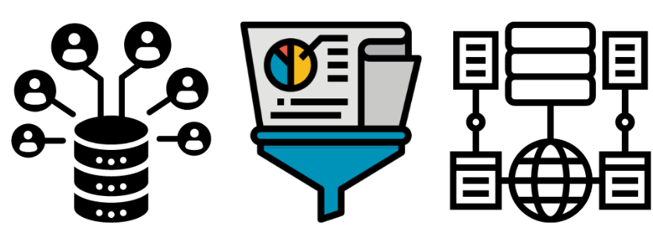
Data Preparation
Creation of new features:
Based on data understanding we might have to create new features from the existing data that can be directly consumed in the model.
Dimensionality reduction with PCA: PCA reduces the number of features in the dataset, keeping only those that are the most valuable for future decision making.
Data annotation: If it is supervised problem and there is no label information or little label information, then we need to create the label/target data first. The process of assigning labels to each data sample is called data annotation or data labeling.
Collected data is messy. There are many problems that machine learning engineers face when dealing with raw data. Here are the most common issues:
Relevant data should be filtered. Irrelevant data should be cleaned up.
Noise, delusive and erroneous samples should be identified and removed.
Outliers should be recognized and eliminated.
Missing values should be spotted and either removed and imputed by proper methods.
Data should be converted to proper formats.
References: Datacamp, Neptune.ai

Slide 7
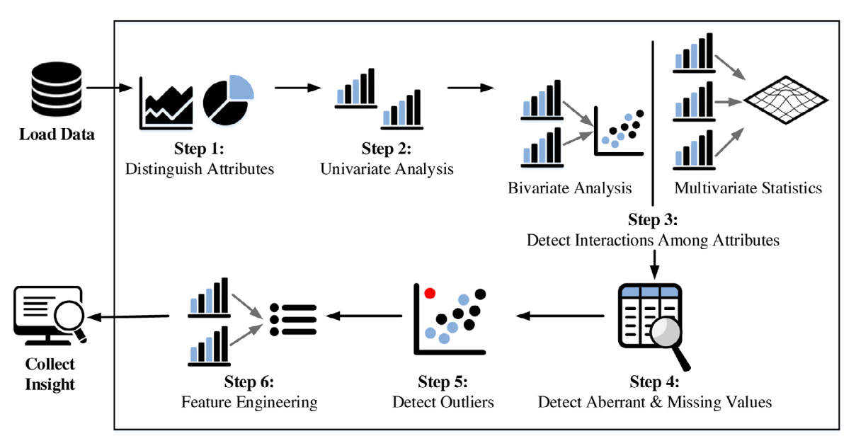
Exploratory Data Analysis
Once we have a first version of our data, we need to perform exploratory data analysis (EDA). The goal of EDA is to probe our data in as many ways as possible to gain an understanding for its characteristics. A few questions that can guide our exploration:
What is the label distribution?
Do we have a balanced/imbalanced dataset?
What are the distributions of feature values?
Are there any features that are malformed?
Is there any relation among the input features?
Is there any correlation between input and target variables?
To what extent there are missing values in the data? Are there any reason and relation for those missing values?
Are there any outliers in the data and how does their distribution look like?
Basics of data analysis techniques:
Missing value analysis
Handling outliers
Univariate analysis
Bivariate analysis
Multivariate analysis
Image credit: Devopedia

Slide 8
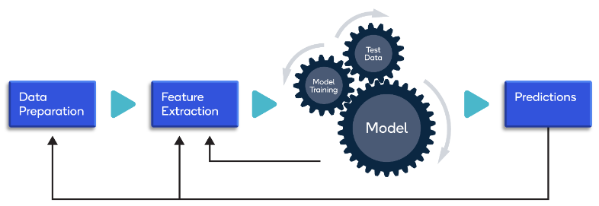
Model Training
Image credit: Qualcomm
In this phase, we will be using all the information from the planning phase to build and train a machine learning model. For example: tracking model metrics, ensuring scalability and robustness, and optimizing storage and compute resources.
Build effective model architecture by doing extensive research.
If required evaluate transfer learning.
Define model metrics in line with business objectives.
Run training experiments and fine tune.
Validating the model on the training and validation dataset.
Tracking experiments, metadata, features, code changes, and machine learning pipelines.
Interpreting the results by incorporating domain knowledge experts.

Slide 9
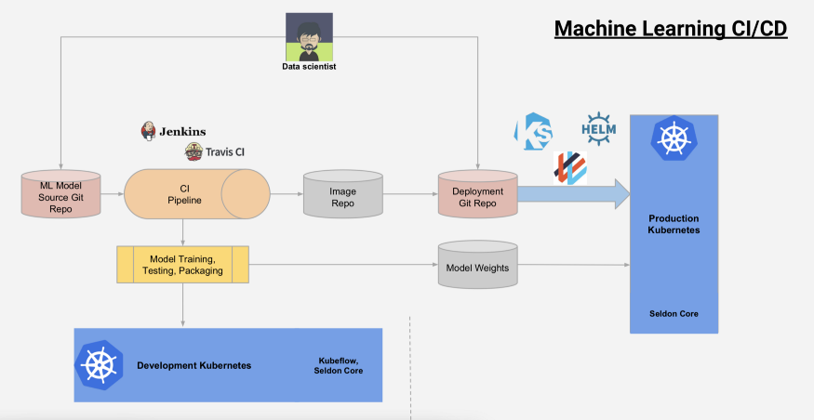
Model Deployment
Deployment:
The ML model deployment denotes a process of the ML model integration into the existing software system. For example: introducing automatic warehouse labeling using the shape of the product. We will be deploying a computer vision model into the current system, which will use the images from the camera to print the labels.
Generally, the models can be deployed on the cloud and local server, web browser, package as software, and edge device. After that, you can use API, web app, plugins, or dashboard to access the predictions.
Image Credit: Kubecon

Slide 10
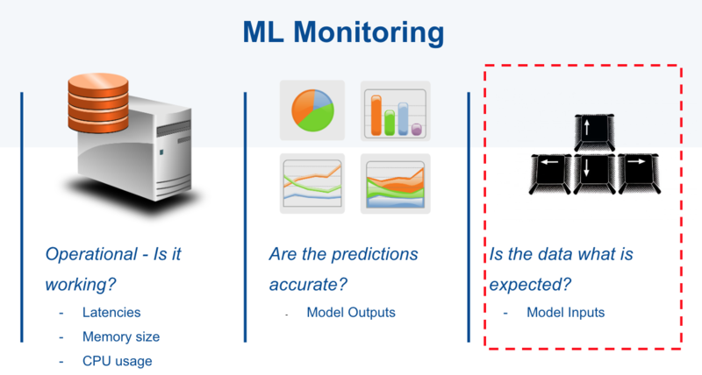
Model Monitoring
Monitoring:
The model is deployed to Production, but the job is far from over, we can’t just relax and wait for a new project. We need to track deployed model performance, to make sure it continues to do the job with the quality that the business requires.
The monitoring can be done completely automatically, and the professionals are notified about the anomalies, reduced model and system performance. Another good practice would be to collect samples that were wrongly processed by the model to figure out the root cause reasons for why it happened and use it for retraining the model making it more robust to such samples.
Image Credit: Christopher

Slide 11
Thank you!

